Slide 1
UNEARTHING THE ENVIRONMENTAL
IMPACT OF HUMAN ACTIVITY : A GLOBAL
CO2EMISSION ANALYSIS
TEAM LEADER : SHUNMUGAPRIYA T
TEAM MEMBERS : ABIRAMI M
MUTHU GOWRI I
VENNILA SANKARI M
DEPARTMENT : MATHEMATICS
COLLEGE : THIRUVALLUVAR COLLEGE,
Papanasam.

Slide 2
OVERVIEW
Carbon dioxide emissions are the primary driver of global climate change. It’s widely recognised that to avoid the worst impacts of climate change, the world needs to urgently reduce emissions. But, how this responsibility is shared between regions, countries and individuals has been an endless point of contention in international discussions.
Growth in emissions was still relatively slow until the mid-20th century. In 1950 the world emitted 6 Billion tonnes of CO2. Emissions have continued to grow rapidly; we now emit over 34 billion tonnes each year.
Fossil fuel use is the primary source of CO2. The data throws light on to how much fossil fuels are burnt, per year per nation, which amounts to an increase in CO2 every year. So countries should set a goal to decrease this amount yearly.
This gives the Global CO2 Emission across countries from 1975 to 2020

Slide 3
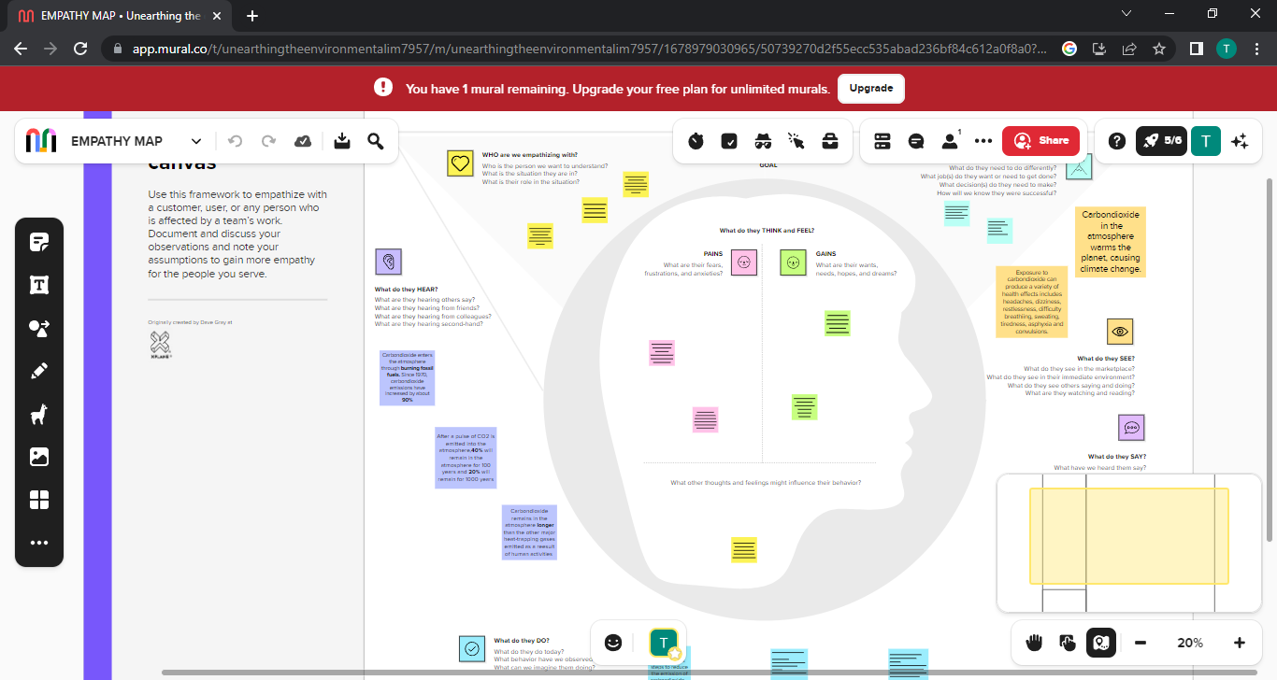
PURPOSE
Carbon dioxide is the greenhouse gas emitted in the largest quantities. Monitoring carbon dioxide emissions is widely seen as crucial to any effort to reduce emissions and thereby slow climate change.
Identifying and quantifying CO2 emissions helps to identify excessive energy usage or other inefficiencies. Lowering GHG emissions typically goes hand in hand with increasing efficiency and cost-effectiveness in a company’s processes.
PROBLEM DEFINITIONS AND DESIGNS THINKING
Effects of carbon dioxide emissions and measures to be taken to prevent its effects
Empathy map

Slide 4
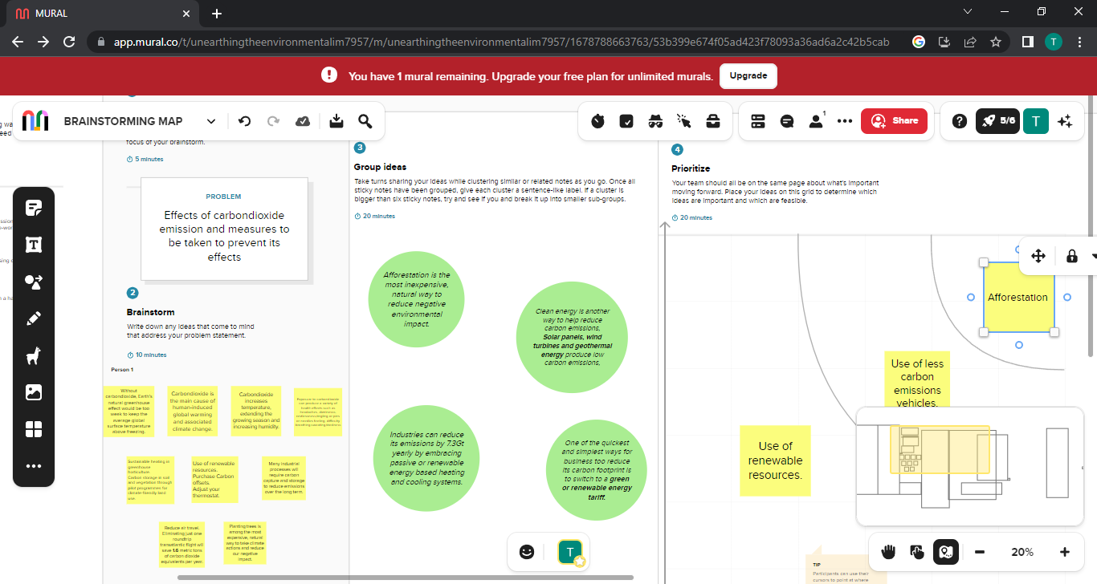
Ideation and brainstorming map

Slide 5
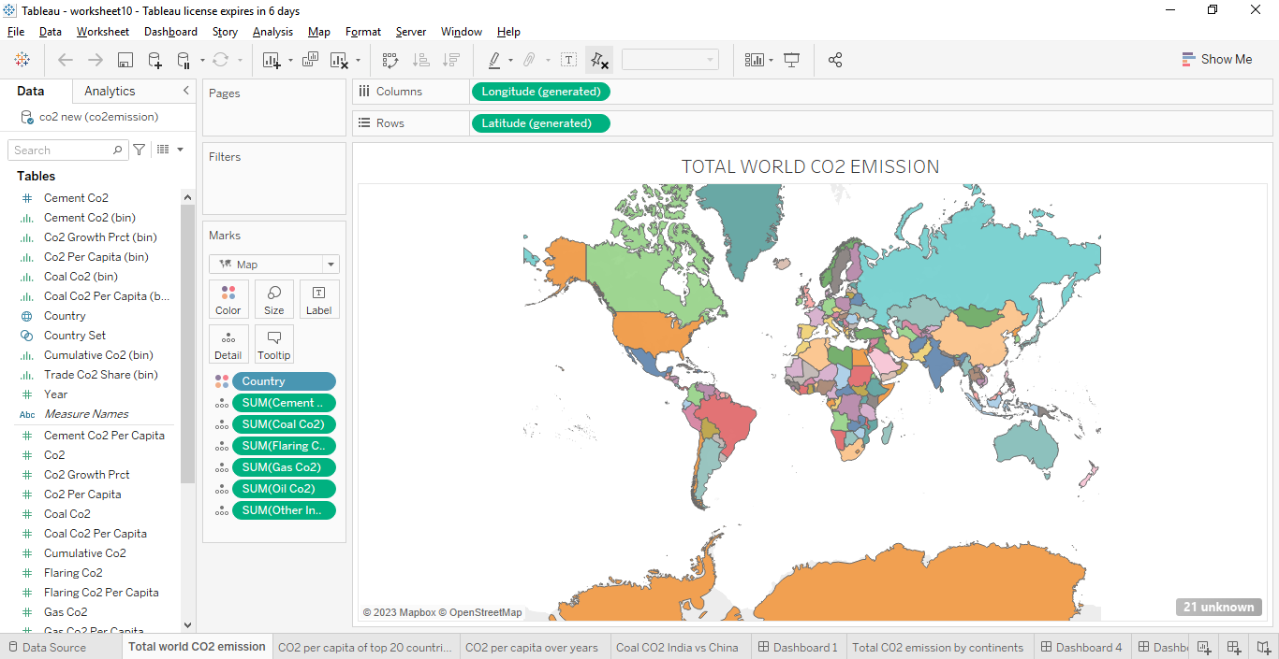
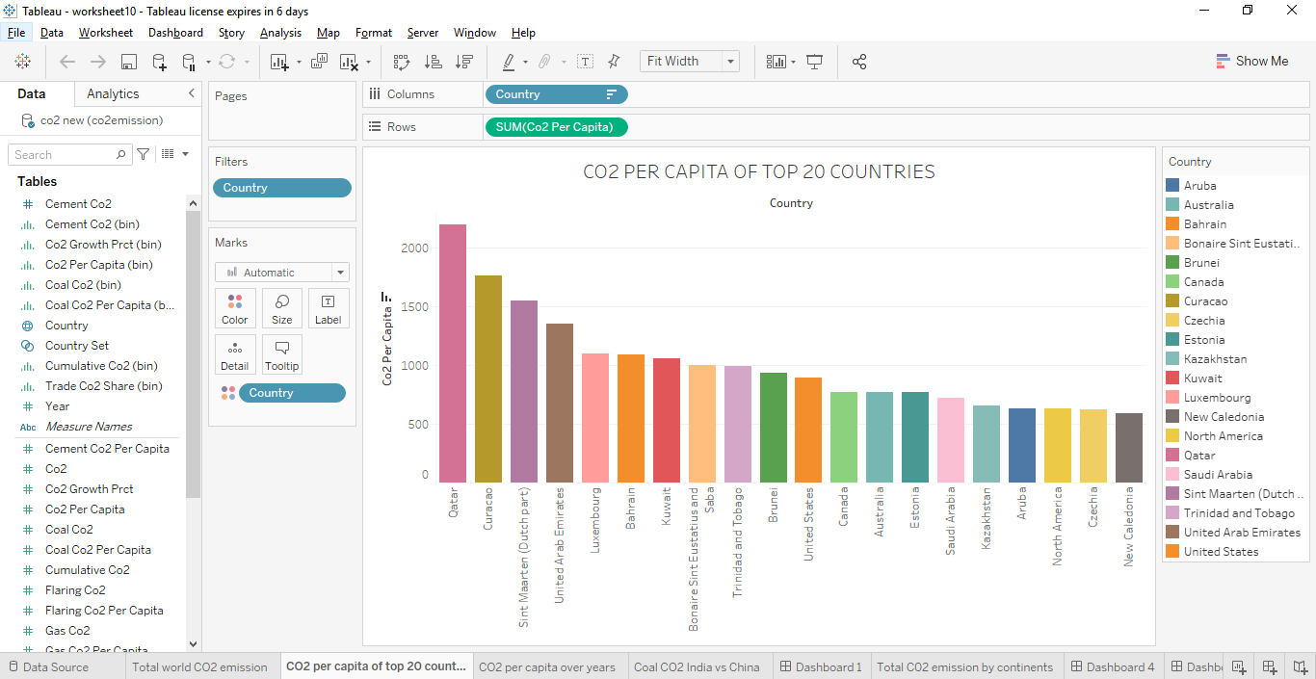
RESULT
TABLEAU OUTPUT

Slide 6
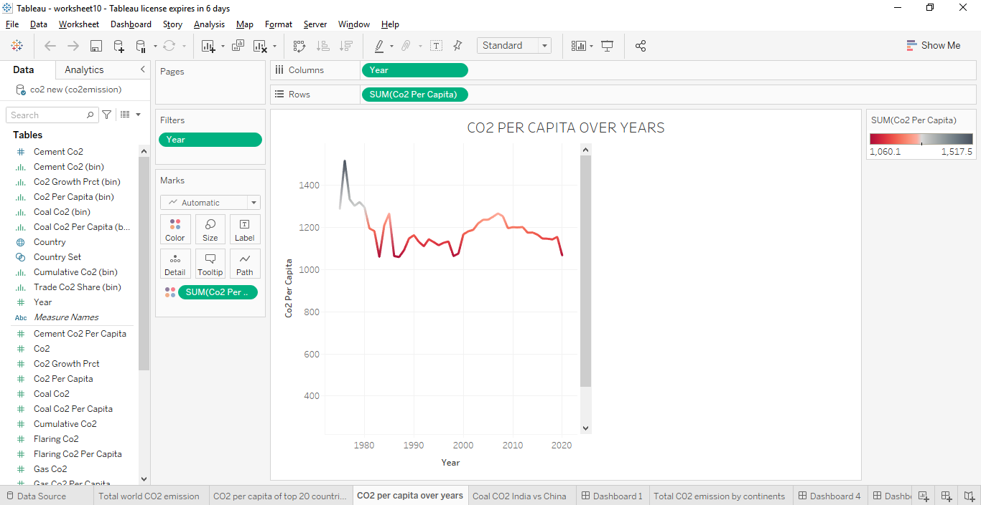
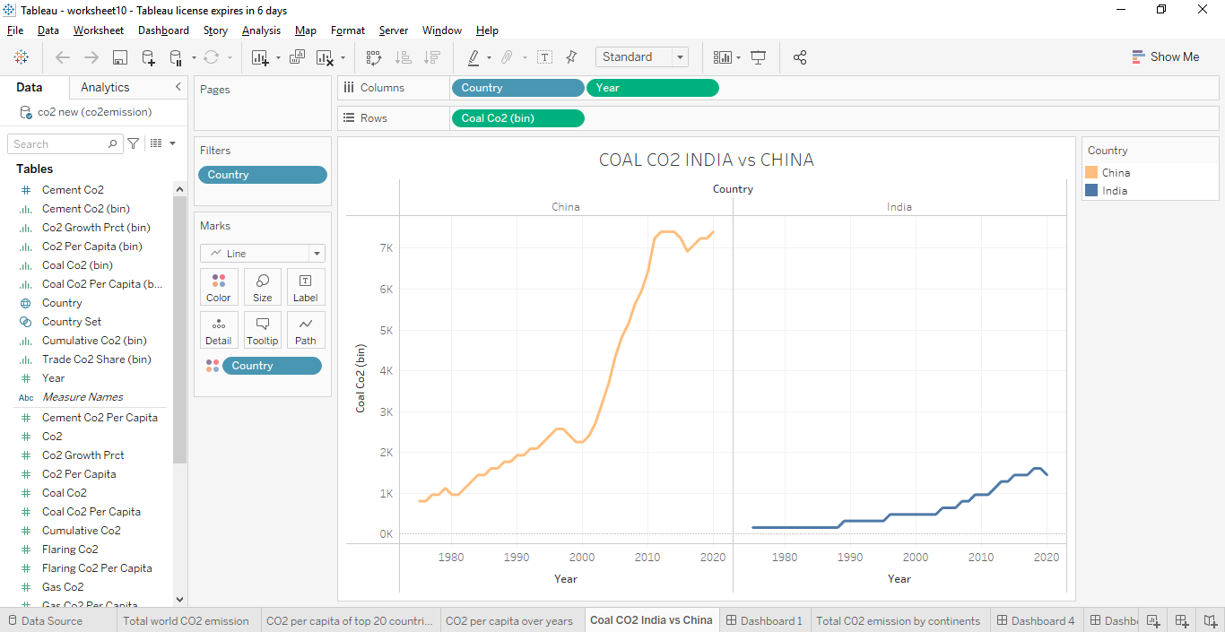

Slide 7
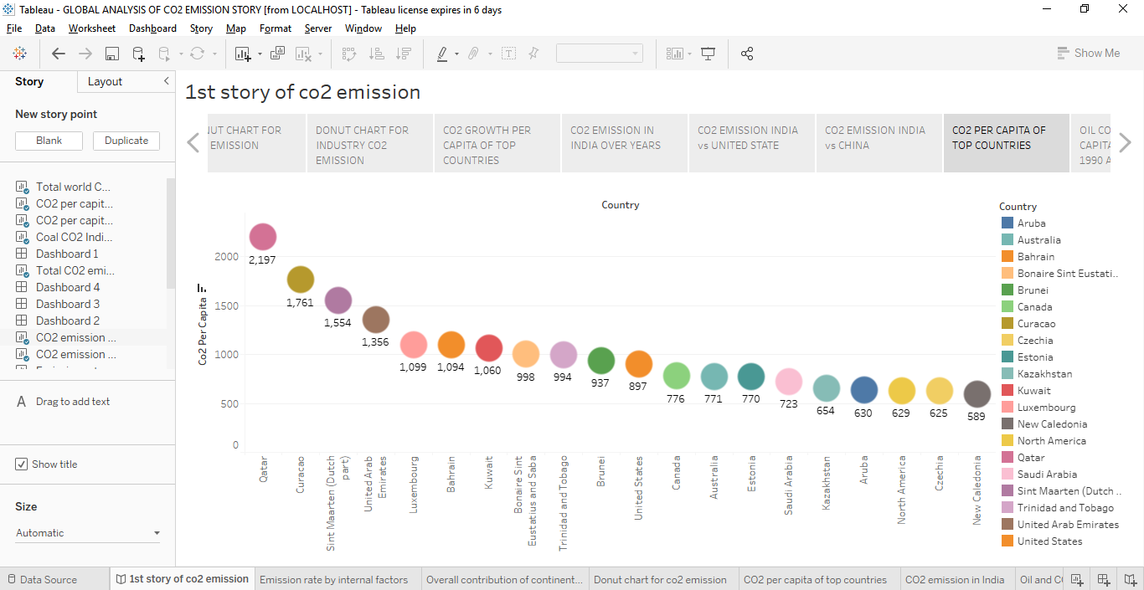
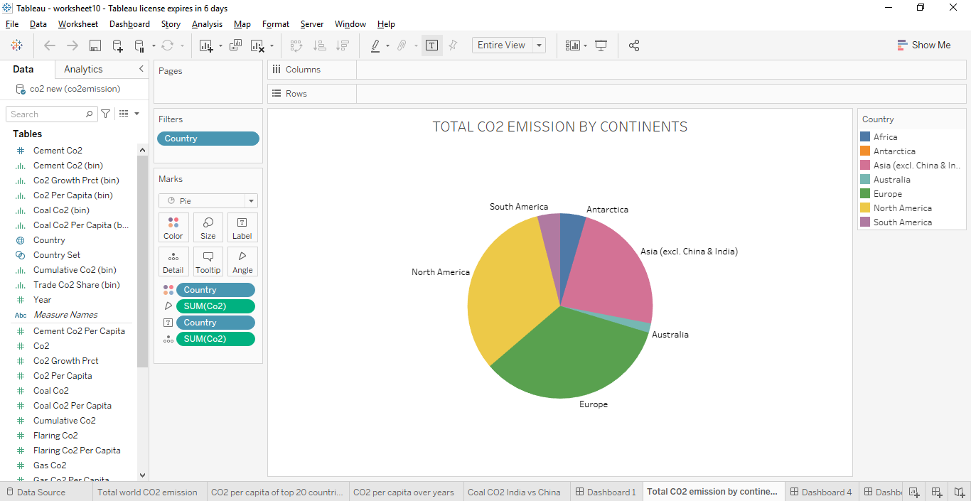

Slide 8
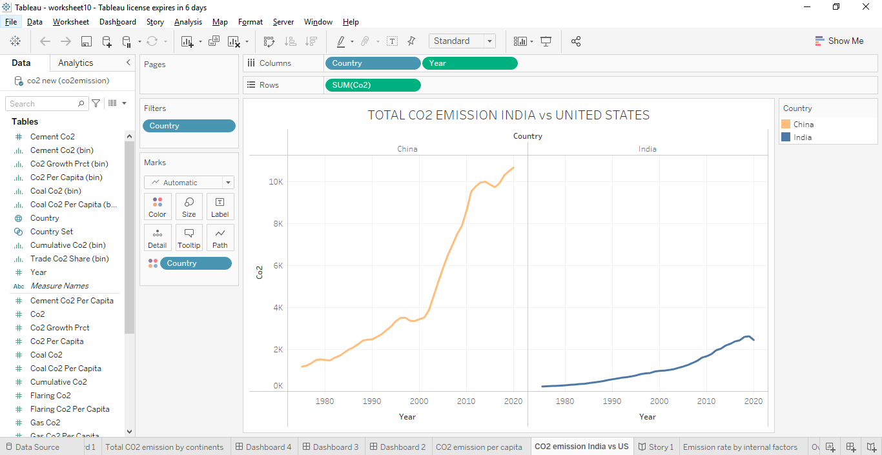
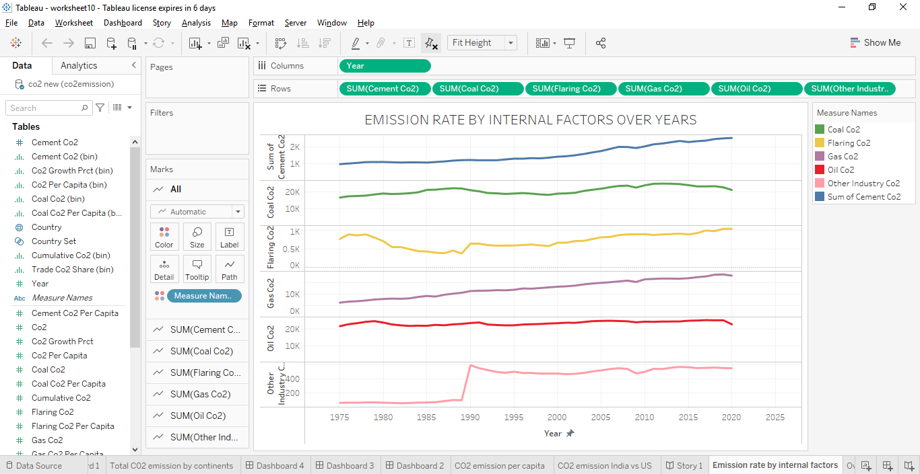

Slide 9
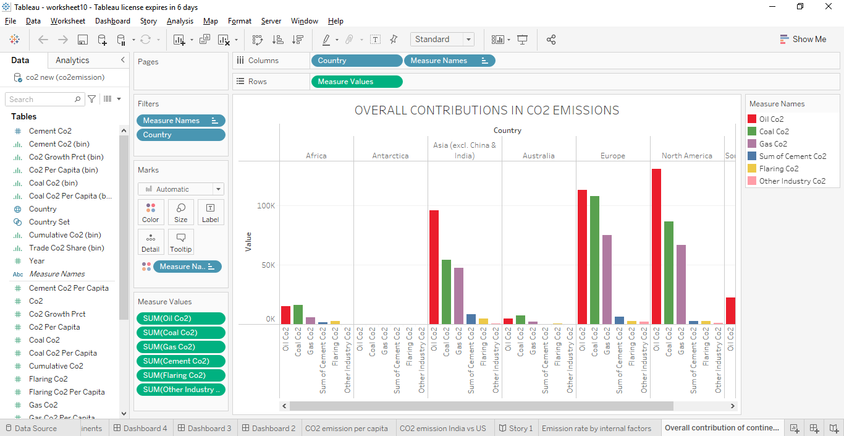
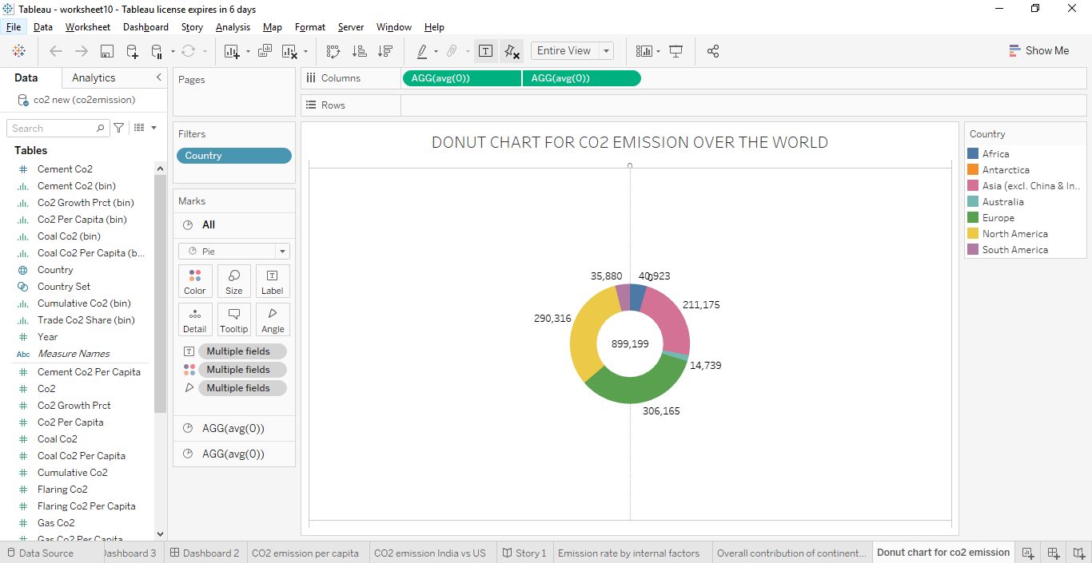

Slide 10
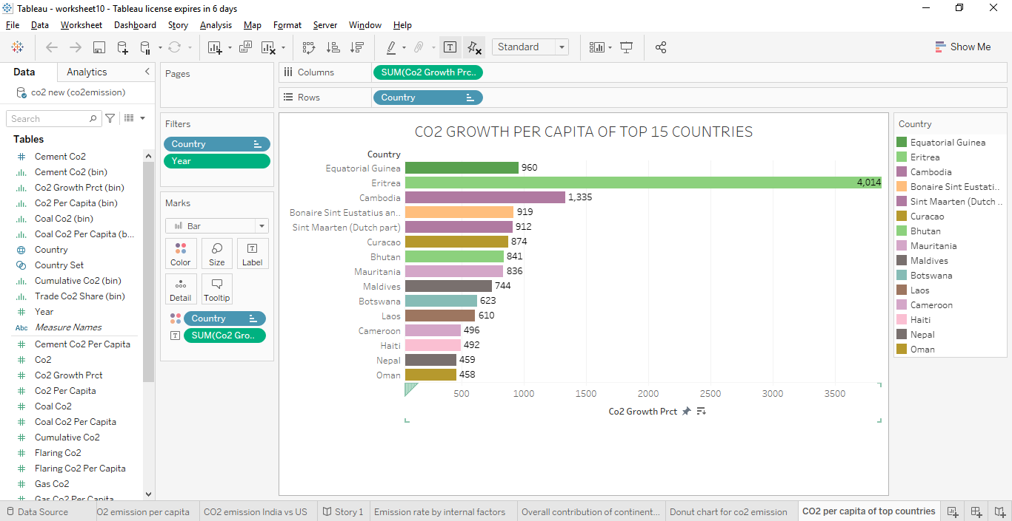
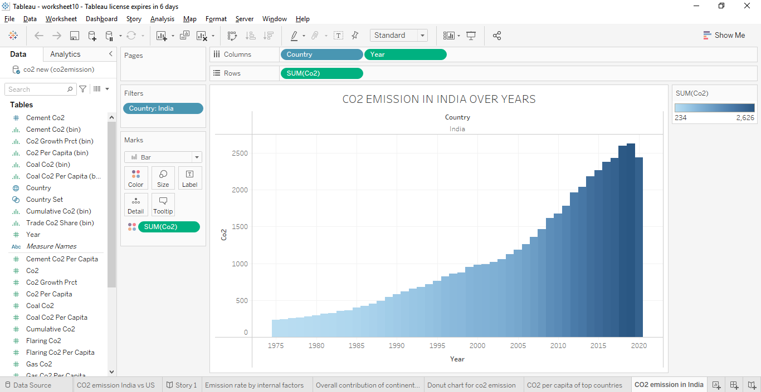

Slide 11
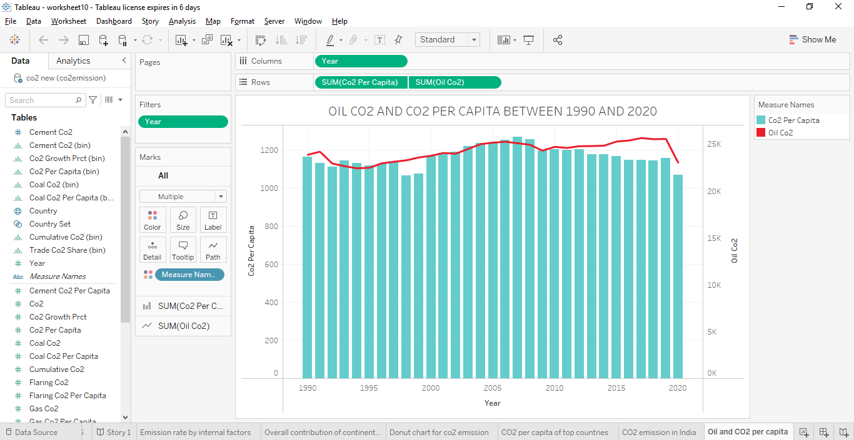
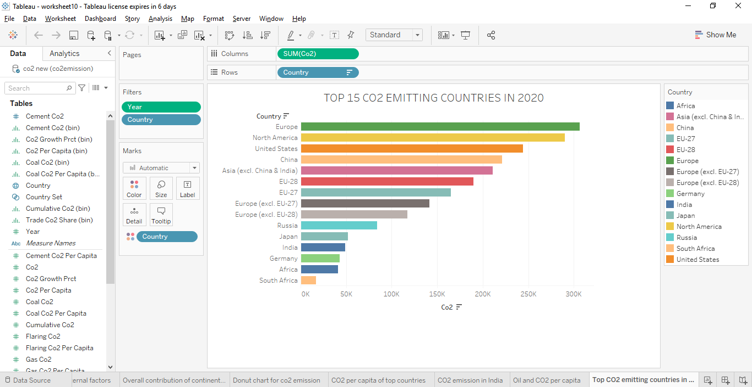
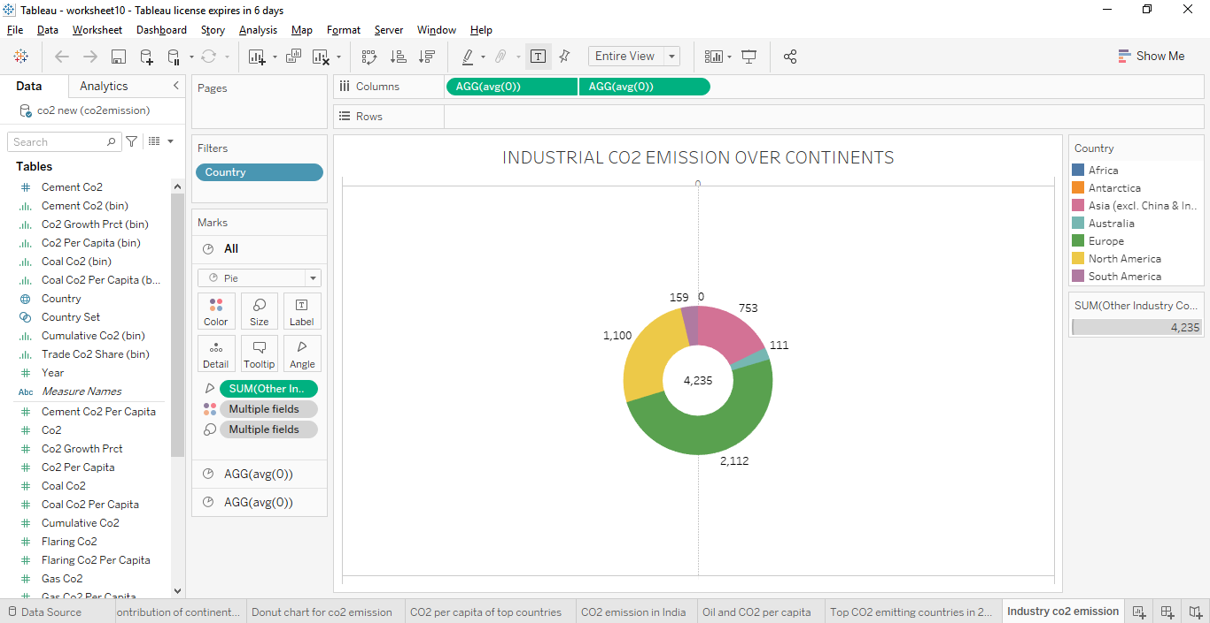

Slide 12
ADVANTAGES AND DISADVANTAGES
Advantages of CO2 :
Carbon dioxide is an important greenhouse gas that helps to trap heat in our atmosphere. Without it, our planet would be inhospitably cold.
Green plants grow faster with more CO2.
Reduction of CO2 emission improves air quality and benefits human health.
CO2 can be used to produce fuels and chemical intermediates through several conversion routes.
CCS can reduce emissions at the source.
Using CCS CO2 can be stored and transported at high energy density in liquid or gaseous form.

Slide 13
Disadvantages of CO2 :
High carbon dioxide level can cause poor air quality and can even extinguish pilot lights on gas-powered appliances.
Increase in CO2 concentrations un our atmosphere is causing average global temperature to rise, disrupting other aspects of Earth’s climate.
CO2 leads to headaches, dizziness, difficulty breathing , tiredness, asphyxia and convulsions in humans.
CO2 in water changes its acidity level.
CO2 increases temperatures, extending the growing seasons and increases humidity.
HEAT WAVES are the major long-term effect of CO2.
CO2 emission leads to toxic acid rains, it adds to coastal and ocean acidification, and it worsens the melting of glaciers and polar ice.
CCS technologies have cost implications.

Slide 14
APPLICATIONS
Identifying and quantifying CO2 emissions helps to identify excessive energy usage or other inefficiencies.
CCS in industrial applications refers to capture, transport and storage of carbon dioxide that would otherwise be emitted from commercial facilities outside the power sector.
CONCLUSION
During the project, we realized the effects of carbon dioxide emission and other internal factors responsible for CO2 emissions.
Hence it is necessary to reduce the rate CO2 emission.

Slide 15
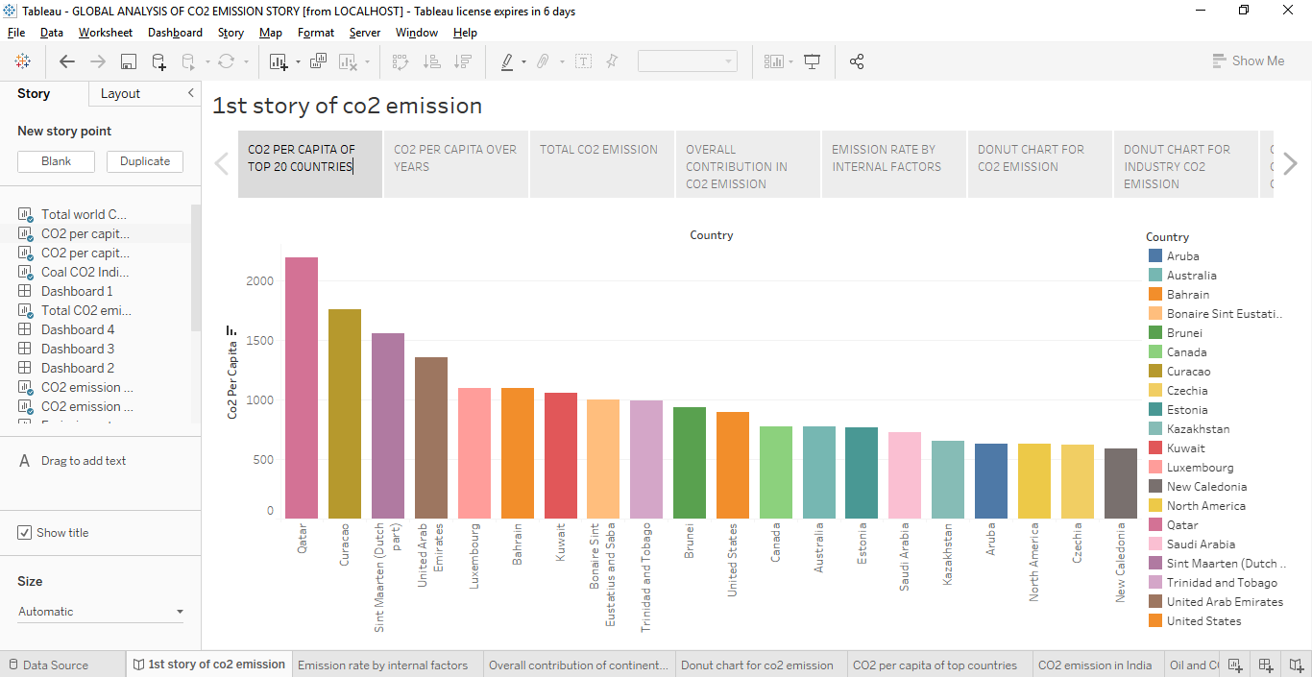
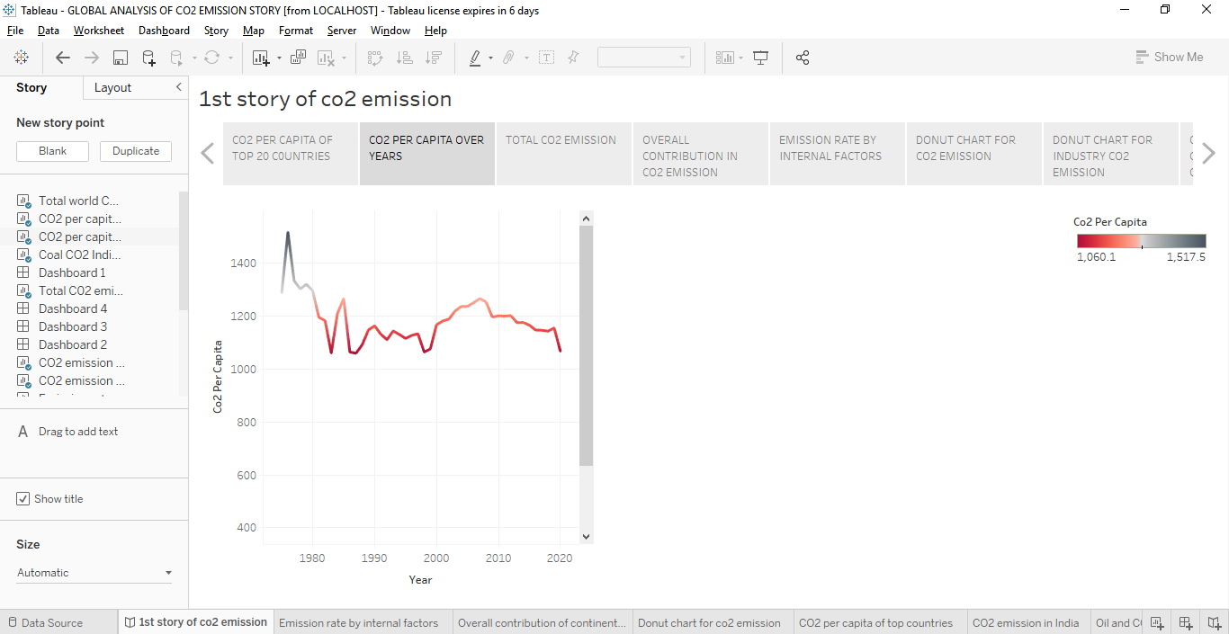
STORY :

Slide 16
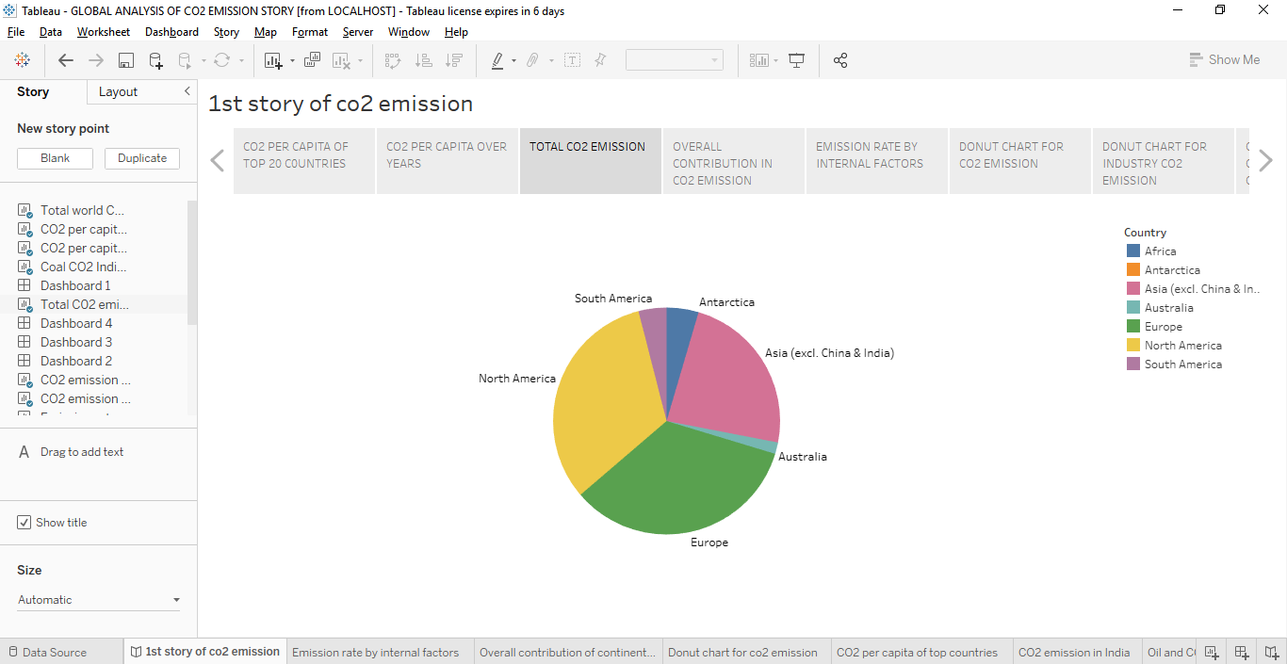
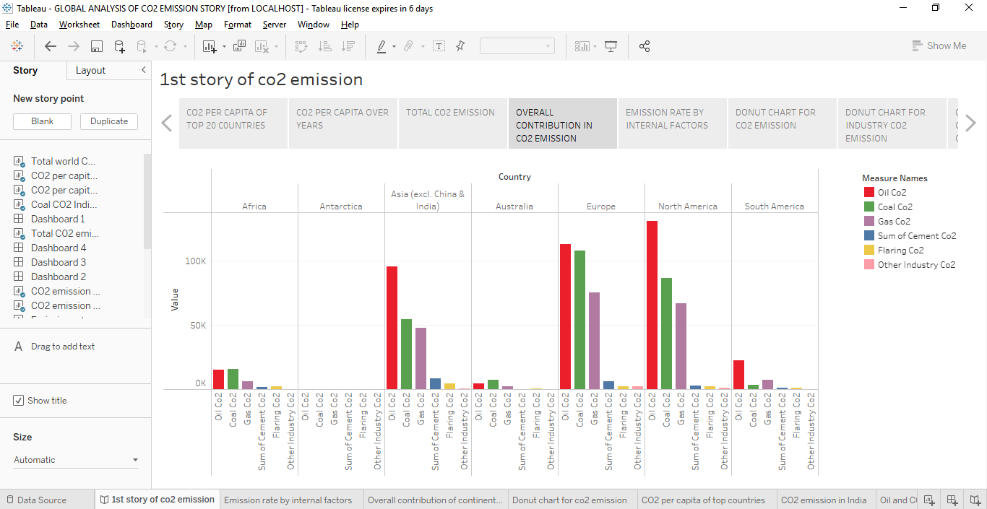
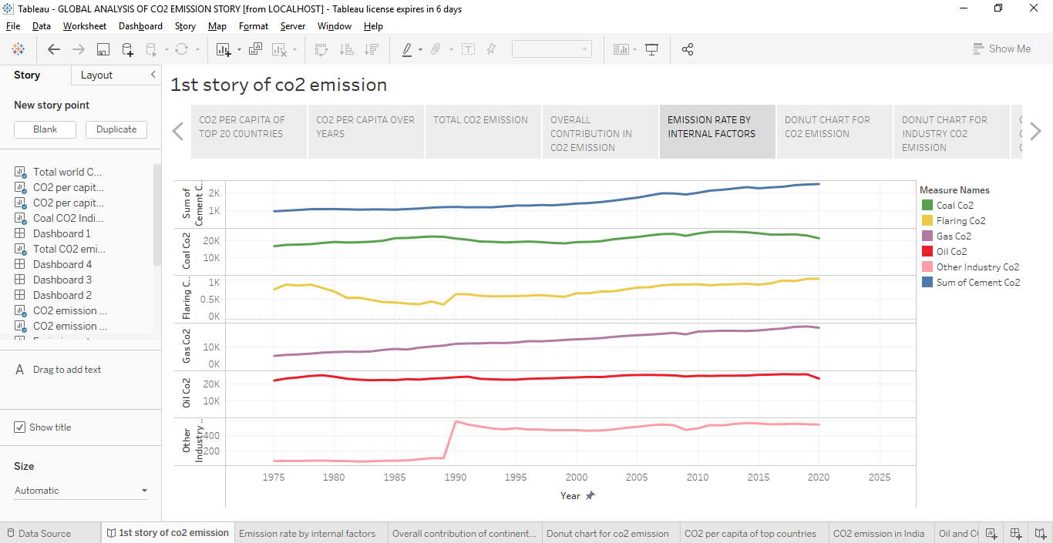

Slide 17
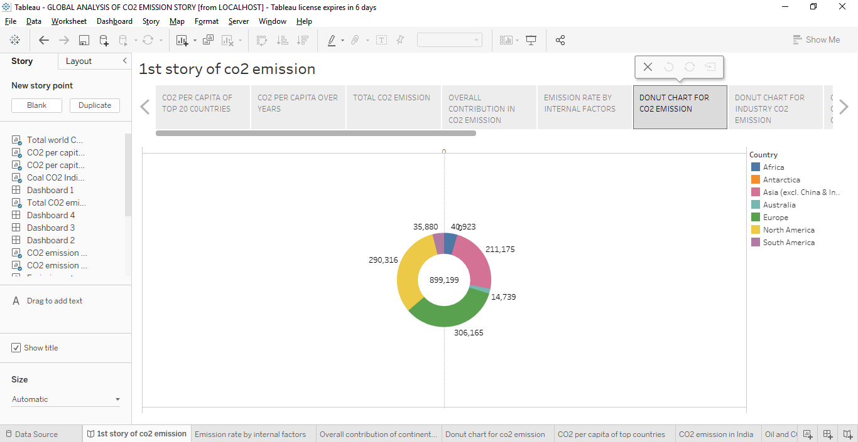
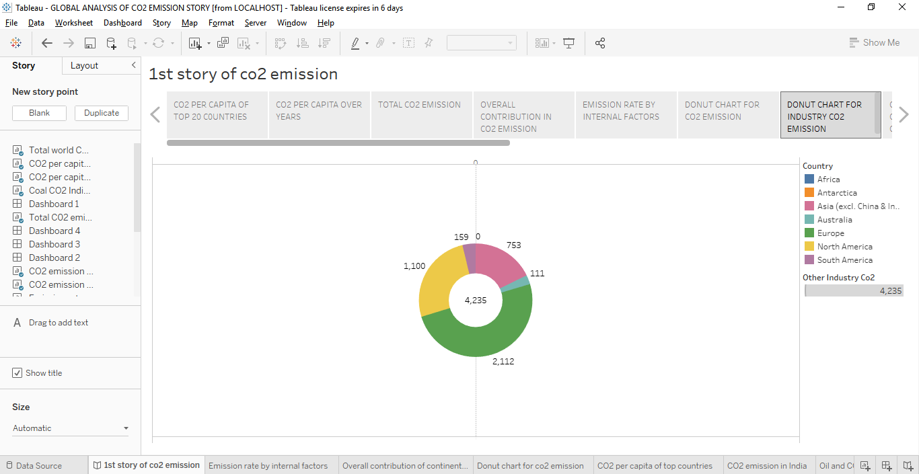
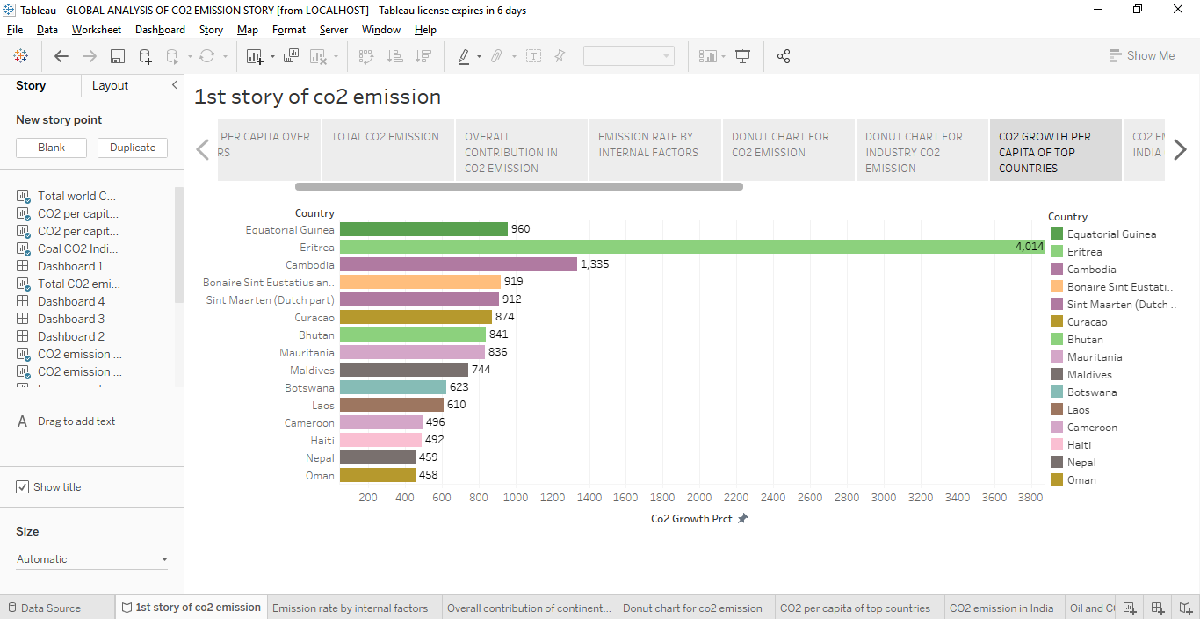

Slide 18
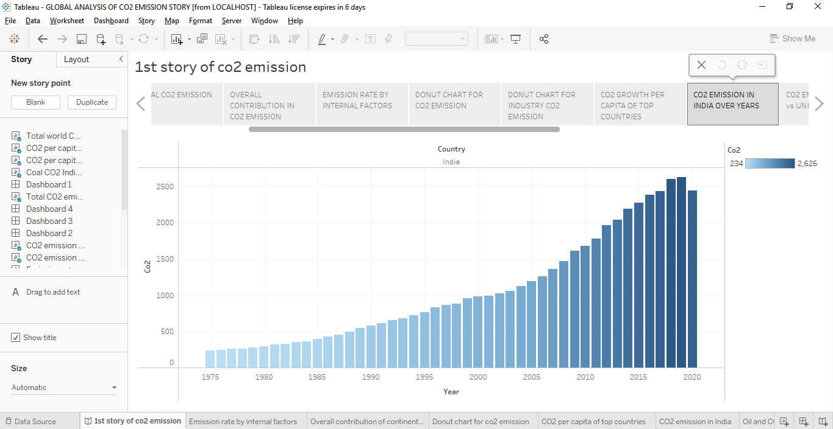
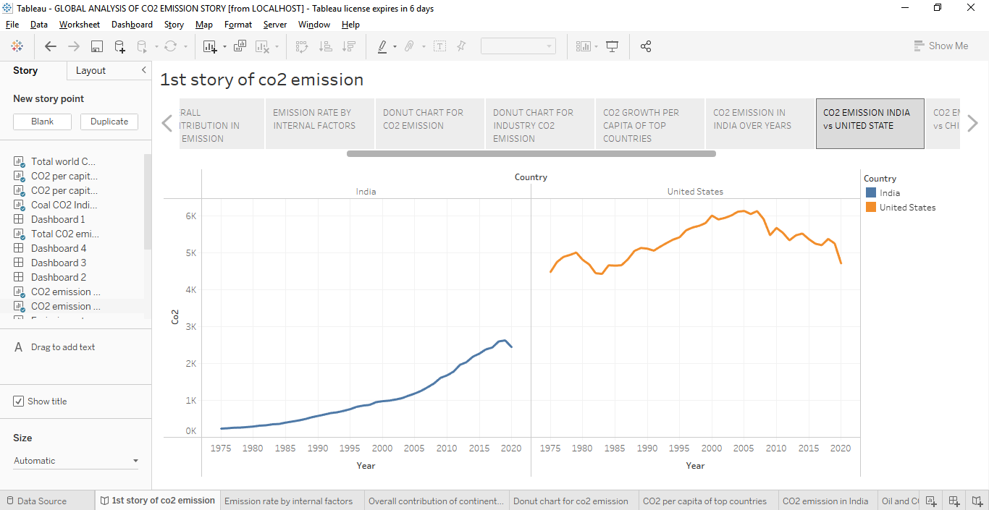
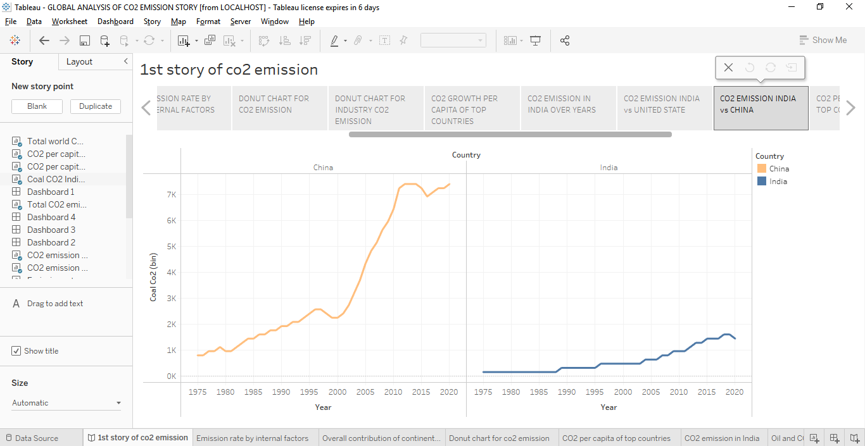

Slide 19
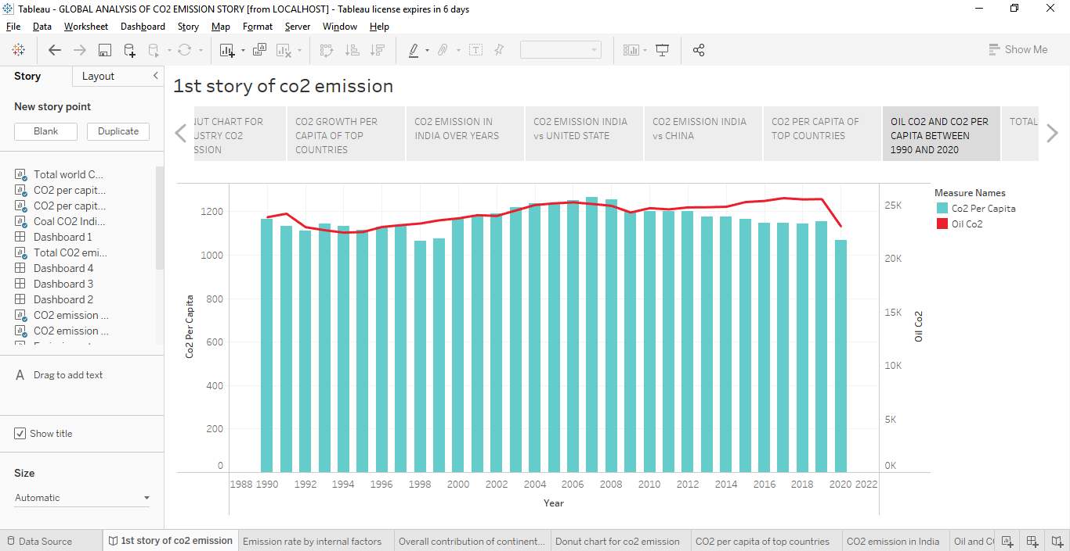

Slide 20
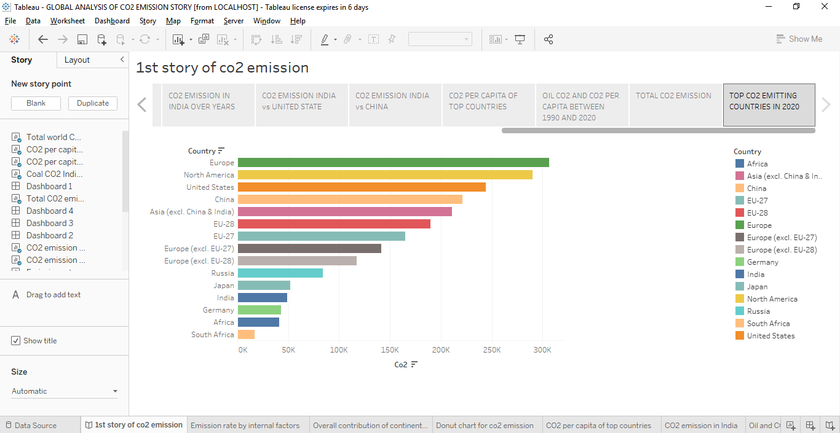
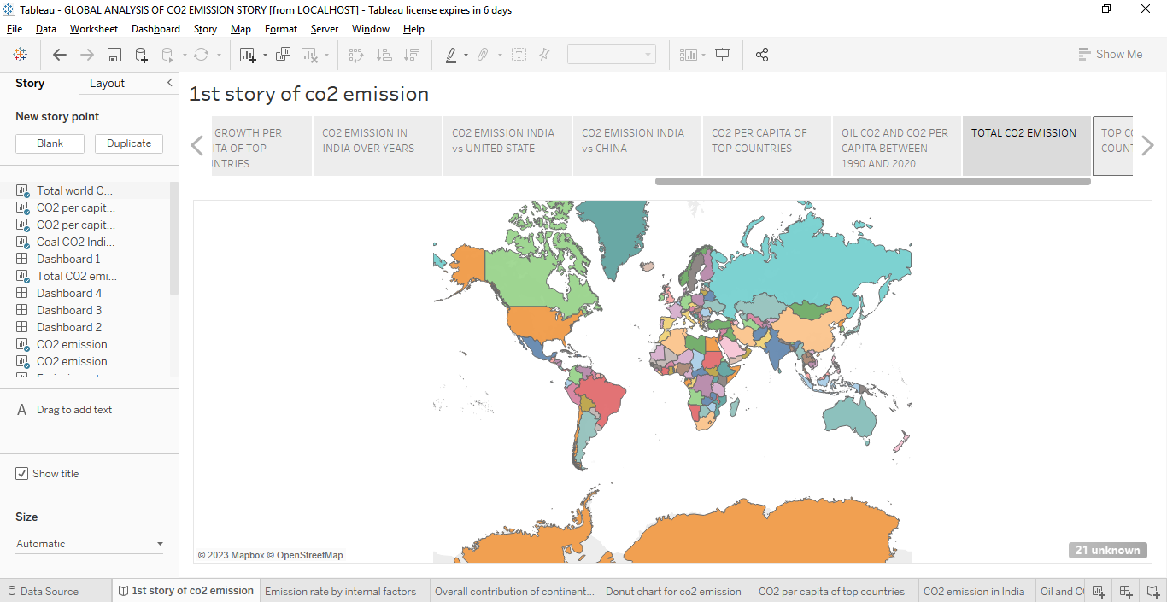

Slide 21
FUTURE IMPACT :
If global energy demand continuous to grow rapidly and we meet it mostly with fossil fuels, human emissions of CO2 could reach 75 billion tonnes per year or more by the end of the century.
Future changes are expected to include a warmer atmosphere, a warmer and more acidic ocean, higher sea levels, and larger changes in precipitation patterns.
APPENDIX :

Slide 22
<!DOCTYPE html>
<html lang="en">
<head>
<meta charset="utf-8">
<meta content="width=device-width, initial-scale=1.0" name="viewport">
<title>Global Co2 Emission Analysis</title>
<meta content="" name="description">
<meta content="" name="keywords">
<!-- Favicons -->
<link href="assets/img/favicon.png" rel="icon">
<link href="assets/img/apple-touch-icon.png" rel="apple-touch-icon">
<!-- Google Fonts -->
<link href="https://fonts.googleapis.com/css?family=Open+Sans:300,300i,400,400i,600,600i,700,700i|Jost:300,300i,400,400i,500,500i,600,600i,700,700i|Poppins:300,300i,400,400i,500,500i,600,600i,700,700i" rel="stylesheet">

Slide 23
<!-- Vendor CSS Files -->
<link href="assets/vendor/aos/aos.css" rel="stylesheet">
<link href="assets/vendor/bootstrap/css/bootstrap.min.css" rel="stylesheet">
<link href="assets/vendor/bootstrap-icons/bootstrap-icons.css" rel="stylesheet">
<link href="assets/vendor/boxicons/css/boxicons.min.css" rel="stylesheet">
<link href="assets/vendor/glightbox/css/glightbox.min.css" rel="stylesheet">
<link href="assets/vendor/remixicon/remixicon.css" rel="stylesheet">
<link href="assets/vendor/swiper/swiper-bundle.min.css" rel="stylesheet">
<!-- Template Main CSS File -->
<link href="assets/css/style.css" rel="stylesheet">
<!-- =======================================================
* Template Name: Arsha - v4.10.0
* Template URL: https://bootstrapmade.com/arsha-free-bootstrap-html-template-corporate/
* Author: BootstrapMade.com
* License: https://bootstrapmade.com/license/
======================================================== -->
</head>
<body>

Slide 24
<!-- ======= Header ======= -->
<header id="header" class="fixed-top ">
<div class="container d-flex align-items-center justify-content-between">
<h1 class="logo"><img src="https://media.istockphoto.com/id/1323550608/vector/co2-reduction-cloud-eco-vector-icon.jpg?s=612x612&w=0&k=20&c=jO3OZfYAg9gB8TWvzH8BR64Lq3pFrfHcOvxpSgB-cjA="> </h1>
<!-- Uncomment below if you prefer to use an image logo -->
<!-- <a href="index.html" class="logo me-auto"><img src="assets/img/logo.png" alt="" class="img-fluid"></a>-->

Slide 25
<nav id="navbar" class="navbar">
<ul>
<li><a class="nav-link scrollto active" href="#hero">Home</a></li>
<li><a class="nav-link scrollto" href="#about">About</a></li>
<li><a class="nav-link scrollto" href="#dash">Dashboard</a></li>
<li><a class="nav-link scrollto" href="#services">Story</a></li>
<li><a class="nav-link scrollto" href="#portfolio">Visualizations</a></li>
<li><a class="nav-link scrollto" href="#report">Report</a></li>
<li><a class="nav-link scrollto" href="#contact">Contact</a></li>
</ul>
<i class="bi bi-list mobile-nav-toggle"></i>
</nav>
<!-- .navbar -->
</div>
</header>
<!-- End Header -->
<!-- ======= Hero Section ======= -->
<section id="hero" class="d-flex align-items-center">

Slide 26
<nav id="navbar" class="navbar">
<ul>
<li><a class="nav-link scrollto active" href="#hero">Home</a></li>
<li><a class="nav-link scrollto" href="#about">About</a></li>
<li><a class="nav-link scrollto" href="#dash">Dashboard</a></li>
<li><a class="nav-link scrollto" href="#services">Story</a></li>
<li><a class="nav-link scrollto" href="#portfolio">Visualizations</a></li>
<li><a class="nav-link scrollto" href="#report">Report</a></li>
<li><a class="nav-link scrollto" href="#contact">Contact</a></li>
</ul>
<i class="bi bi-list mobile-nav-toggle"></i>
</nav>
<!-- .navbar -->
</div>
</header>
<!-- End Header -->
<!-- ======= Hero Section ======= -->
<section id="hero" class="d-flex align-items-center">

Slide 27
<!-- ======= Hero Section ======= -->
<section id="hero" class="d-flex align-items-center">
<div class="container">
<div class="row">
<div class="col-lg-6 d-flex flex-column justify-content-center pt-4 pt-lg-0 order-2 order-lg-1" data-aos="fade-up" data-aos-delay="200">
<h1>Welcome to Global Co2 Emission Analysis for Year 2020</h1>
<h2>Carbon dioxide emissions are the primary driver of global climate change. It’s widely recognised that to avoid the worst impacts of climate change, the world needs to urgently reduce emissions.</h2>
<div class="d-flex justify-content-center justify-content-lg-start">
<a href="#about" class="btn-get-started scrollto">Get Started</a>
<a href="https://www.youtube.com/watch?v=jDDaplaOz7Q" class="glightbox btn-watch-video"></a>

Slide 28
<!-- ======= Hero Section ======= -->
<section id="hero" class="d-flex align-items-center">
<div class="container">
<div class="row">
<div class="col-lg-6 d-flex flex-column justify-content-center pt-4 pt-lg-0 order-2 order-lg-1" data-aos="fade-up" data-aos-delay="200">
<h1>Welcome to Global Co2 Emission Analysis for Year 2020</h1>
<h2>Carbon dioxide emissions are the primary driver of global climate change. It’s widely recognised that to avoid the worst impacts of climate change, the world needs to urgently reduce emissions.</h2>
<div class="d-flex justify-content-center justify-content-lg-start">
<a href="#about" class="btn-get-started scrollto">Get Started</a>
<a href="https://www.youtube.com/watch?v=jDDaplaOz7Q" class="glightbox btn-watch-video"></a>

Slide 29
<div class="section-title">
<h2>About Us</h2>
</div>
<div class="row content">
<div class="col-lg-12">
<p>
Carbon dioxide emissions are those stemming from the burning of fossil fuels and the manufacture of cement. They include carbon dioxide produced during consumption of solid, liquid, and gas fuels and gas flaring.
</p>
<p>
Global carbon dioxide (CO2) emissions from fossil fuels and industry have increased considerably since 2000, and in 2019 reached a record high of 36.7 billion metric tons of CO2. In 2020, the COVID-19 pandemic caused global CO2 emissions to plummet five
percent to 34.81 billion metric tons.</p>

Slide 30
<p> Historically, major global events cause emission reductions. The 2009 global recession caused worldwide CO2 emissions to fall by approximately 460 million metric tons. But this pales in comparison to the emission reductions in
2020. Countries around the world were put under strict lockdowns, meaning transportation and industrial activities were significantly reduced. CO2 emission levels in India dropped for the first time in four decades in the year
ending March 2020. Global CO2 emissions per capita also experienced a substantial decline in 2020, falling to an average of 4.47 metric tons per person.</p>
</div>
</div>
</div>
</section>
<!-- End About Us Section -->
<!-- ======= Why Us Section ======= -->
<section id="dash" class="">
<div class="container-fluid" data-aos="fade-up">
<div class="section-title">
<h2>Dashboard</h2>
</div>

Slide 31
<div class='tableauPlaceholder' id='viz1681540320781' style='position: relative'><noscript><a href='#'><img alt='Dashboard 1 ' src='https:&#47;&#47;public.tableau.com&#47;static&#47;images&#47;GL&#47;GLOBALANALYSISOFCO2EMISSION&#47;Dashboard1&#47;1_rss.png' style='border: none' /></a></noscript><object class='tableauViz' style='display:none;'><param name='host_url' value='https%3A%2F%2Fpublic.tableau.com%2F' /> <param name='embed_code_version' value='3' /> <param name='site_root' value='' /><param name='name' value='GLOBALANALYSISOFCO2EMISSION&#47;Dashboard1' /><param name='tabs' value='no' /><param name='toolbar' value='yes' /><param name='static_image' value='https:&#47;&#47;public.tableau.com&#47;static&#47;images&#47;GL&#47;GLOBALANALYSISOFCO2EMISSION&#47;Dashboard1&#47;1.png' /> <param name='animate_transition'

Slide 32
value='yes' /><param name='display_static_image' value='yes' /><param name='display_spinner' value='yes' /><param name='display_overlay' value='yes' /><param name='display_count' value='yes' /><param name='language' value='en-US' /></object></div> <script type='text/javascript'> var divElement = document.getElementById('viz1681540320781'); var vizElement = divElement.getElementsByTagName('object')[0]; if ( divElement.offsetWidth > 800 ) { vizElement.style.width='100%';vizElement.style.height=(divElement.offsetWidth*0.75)+'px';} else if ( divElement.offsetWidth > 500 ) { vizElement.style.width='100%';vizElement.style.height=(divElement.offsetWidth*0.75)+'px';} else { vizElement.style.width='100%';vizElement.style.height='1277px';} var scriptElement = document.createElement('script'); scriptElement.src = 'https://public.tableau.com/javascripts/api/viz_v1.js';

Slide 33
value='yes' /><param name='display_static_image' value='yes' /><param name='display_spinner' value='yes' /><param name='display_overlay' value='yes' /><param name='display_count' value='yes' /><param name='language' value='en-US' /></object></div> <script type='text/javascript'> var divElement = document.getElementById('viz1681540320781'); var vizElement = divElement.getElementsByTagName('object')[0]; if ( divElement.offsetWidth > 800 ) { vizElement.style.width='100%';vizElement.style.height=(divElement.offsetWidth*0.75)+'px';} else if ( divElement.offsetWidth > 500 ) { vizElement.style.width='100%';vizElement.style.height=(divElement.offsetWidth*0.75)+'px';} else { vizElement.style.width='100%';vizElement.style.height='1277px';} var scriptElement = document.createElement('script'); scriptElement.src = 'https://public.tableau.com/javascripts/api/viz_v1.js';

Slide 34
} else {
vizElement.style.width = '100%';
vizElement.style.height = '1477px';
}
var scriptElement = document.createElement('script');
scriptElement.src = 'https://public.tableau.com/javascripts/api/viz_v1.js';
vizElement.parentNode.insertBefore(scriptElement, vizElement);
</script>
</div>
<!-- End Why Us Section -->
<section id="services" class="services">
<div class="container" data-aos="fade-up">
<div class="section-title">
<h2>Story</h2>
</div>

Slide 35
<!-- End Why Us Section -->
<section id="services" class="services">
<div class="container" data-aos="fade-up">
<div class="section-title">
<h2>Story</h2>
</div>
<div class='tableauPlaceholder' id='viz1672206123585' style='position: relative'>
<noscript><a href='#'><img alt='CO2 Emission Story ' src='https:&#47;&#47;public.tableau.com&#47;static&#47;images&#47;G4&#47;G4Q8N94F4&#47;1_rss.png' style='border: none' /></a>
</noscript><object class='tableauViz' style='display:none;'>
<param name='host_url' value='https%3A%2F%2Fpublic.tableau.com%2F
<div class='tableauPlaceholder' id='viz1681540413398' style='position: relative'><noscript><a href='#'><img alt='1st story of co2 emission ' src='https:&#47;&#47;public.tableau.com&#47;static&#47;images&#47;GL&#47;GLOBALANALYSISOFCO2EMISSIONSTORY&#47;1ststoryofco2emission&#47;1_rss.png' style='border: none' /></a></noscript><object class='tableauViz' style='display:none;'><param name='host_url' value='https%3A%2F%2Fpublic.tableau.com%2F' /> <param name='embed_code_version' value='3' /> <param name='site_root' value='' /><param name='name' value='GLOBALANALYSISOFCO2EMISSIONSTORY&#47;1ststoryofco2emission' /><param name='tabs' value='no' /><param name='toolbar' value='yes' /><param name='static_image'

Slide 36
value='https:&#47;&#47;public.tableau.com&#47;static&#47;images&#47;GL&#47;GLOBALANALYSISOFCO2EMISSIONSTORY&#47;1ststoryofco2emission&#47;1.png' /> <param name='animate_transition' value='yes' /><param name='display_static_image' value='yes' /><param name='display_spinner' value='yes' /><param name='display_overlay' value='yes' /><param name='display_count' value='yes' /><param name='language' value='en-US' /></object></div> <script type='text/javascript'> var divElement = document.getElementById('viz1681540413398'); var vizElement = divElement.getElementsByTagName('object')[0]; vizElement.style.width='100%';vizElement.style.height=(divElement.offsetWidth*0.75)+'px'; var scriptElement = document.createElement('script'); scriptElement.src = 'https://public.tableau.com/javascripts/api/viz_v1.js'; vizElement.parentNode.insertBefore(scriptElement, vizElement); </script> <param name='toolbar' value='yes' />

Slide 37
<param name='static_image' value='https:&#47;&#47;public.tableau.com&#47;static&#47;images&#47;G4&#47;G4Q8N94F4&#47;1.png' />
<param name='animate_transition' value='yes' />
<param name='display_static_image' value='yes' />
<param name='display_spinner' value='yes' />
<param name='display_overlay' value='yes' />
<param name='display_count' value='yes' />
<param name='language' value='en-US' /></object></div>
<script type='text/javascript'>
var divElement = document.getElementById('viz1672206123585');
var vizElement = divElement.getElementsByTagName('object')[0];
vizElement.style.width = '100%';
vizElement.style.height = (divElement.offsetWidth * 0.75) + 'px';
var scriptElement = document.createElement('script');
scriptElement.src = 'https://public.tableau.com/javascripts/api/viz_v1.js';
vizElement.parentNode.insertBefore(scriptElement, vizElement);
</script>
</div>
</section>
<!-- ======= Skills Section ======= -->
<!-- End Skills Section -->
<!-- End Services Section -->
<!-- ======= Cta Section ======= -->
<!-- End Cta Section -->

Slide 38
<param name='static_image' value='https:&#47;&#47;public.tableau.com&#47;static&#47;images&#47;G4&#47;G4Q8N94F4&#47;1.png' />
<param name='animate_transition' value='yes' />
<param name='display_static_image' value='yes' />
<param name='display_spinner' value='yes' />
<param name='display_overlay' value='yes' />
<param name='display_count' value='yes' />
<param name='language' value='en-US' /></object></div>
<script type='text/javascript'>
var divElement = document.getElementById('viz1672206123585');
var vizElement = divElement.getElementsByTagName('object')[0];
vizElement.style.width = '100%';
vizElement.style.height = (divElement.offsetWidth * 0.75) + 'px';
var scriptElement = document.createElement('script');
scriptElement.src = 'https://public.tableau.com/javascripts/api/viz_v1.js';
vizElement.parentNode.insertBefore(scriptElement, vizElement);
</script>
</div>
</section>
<!-- ======= Skills Section ======= -->
<!-- End Skills Section -->
<!-- End Services Section -->
<!-- ======= Cta Section ======= -->
<!-- End Cta Section -->

Slide 39
</div>
</div>
</div>
</div>
<div class="col-lg-4 col-md-6 portfolio-item filter-web">
<div class="portfolio-wrap">
<img src="assets/img/img3.jpg" class="img-fluid" alt="">
<div class="portfolio-info">
<h4>Image 2 </h4>
<div class="portfolio-links">
<a href="assets/img/portfolio/p1.jpg" data-gallery="portfolioGallery" class="portfolio-lightbox" title="Web 3"><i class="bx bx-plus"></i></a>
</div>
</div>
</div>
</div>
<div class="col-lg-4 col-md-6 portfolio-item filter-web">
<div class="portfolio-wrap">
<img src="assets/img/img4.jpg" class="img-fluid" alt="">
<div class="portfolio-info">
<h4>Image 3 </h4>

Slide 40
<div class="portfolio-links">
<a href="assets/img/portfolio/p1.jpg" data-gallery="portfolioGallery" class="portfolio-lightbox" title="Web 3"><i class="bx bx-plus"></i></a>
</div>
</div>
</div>
</div>
<div class="col-lg-4 col-md-6 portfolio-item filter-web">
<div class="portfolio-wrap">
<img src="assets/img/img5.jpg" class="img-fluid" alt="">
<div class="portfolio-info">
<h4>Image 5</h4>

Slide 41
<div class="portfolio-links">
<a href="assets/img/portfolio/p5.jpg" data-gallery="portfolioGallery" class="portfolio-lightbox" title="Web 3"><i class="bx bx-plus"></i></a>
</div>
</div>
</div>
</div>
<div class="col-lg-4 col-md-6 portfolio-item filter-web">
<div class="portfolio-wrap">
<img src="assets/img/img6.jpg" class="img-fluid" alt="">
<div class="portfolio-info">
<h4>Image 6</h4>
<div class="portfolio-links">
<a href="assets/img/portfolio/p5.jpg" data-gallery="portfolioGallery" class="portfolio-lightbox" title="Web 3"><i class="bx bx-plus"></i></a>
</div>
</div>
</div>
</div>
<div class="col-lg-4 col-md-6 portfolio-item filter-web">
<div class="portfolio-wrap">
<img src="assets/img/img7.jpg" class="img-fluid" alt="">
<div class="portfolio-info">
<h4>Image 4</h4>
<div class="portfolio-links">

Slide 42
<a href="assets/img/portfolio/p5.jpg" data-gallery="portfolioGallery" class="portfolio-lightbox" title="Web 3"><i class="bx bx-plus"></i></a>
</div>
</div>
</div>
</div>
</div>
</div>
</section>
<section id="report" class="skills">
<div class="container" data-aos="fade-up">
<div class="section-title">
<h2>Report</h2>
</div>
<div class="row content">
<div class="col-md-5 order-1 order-md-2" data-aos="fade-right" data-aos-delay="100">
<img src="assets/img/r1.jpg" class="img-fluid" alt="">
</div>
<div class="col-lg-6 pt-4 pt-lg-0 content" data-aos="fade-left" data-aos-delay="100">
<h3>Top Co2 Emitting countries for Past 10 Years</h3>
<br>
<p class="fst-italic">

Slide 43
China is the highest Co2 Emitting country among the other countries.
</p>
<p class="fst-italic">
United States is the second highest Co2 Emitting country.
</p>
<p class="fst-italic">
India is the Third highest Co2 Emitting country.
</p>
</div>
</div>
<br>
<br>
<div class="row content">
<div class="col-md-5" data-aos="fade-right">
<img src="assets/img/r2.jpg" class="img-fluid" alt="">
</div>
<div class="col-md-7 pt-5" data-aos="fade-left">
<h3>Continents Contribution towards Co2 Emission</h3>
<br>
<p class="fst-italic">
Asian is the highest Co2 Emitting country among the other continents.
</p>
<p class="fst-italic">
Europe is the second highest Co2 Emitting continent.
</p>
<p class="fst-italic">
Antartica is the lowest Co2 Emitting countries because of low human activity/existence in the continent.
</p>
</div>
<br>
<br>
<div class="row content">

Slide 44
<br>
<div class="row content">
<div class="col-md-5" data-aos="fade-right">
<img src="assets/img/r3.jpg" class="img-fluid" alt="">
</div>
<div class="col-md-7 pt-5" data-aos="fade-left">
<h3>Overall India Contribution towards Co2 Emission</h3>
<br>
<p class="fst-italic">
Coal is the highest factor of Co2 Emission.
</p>
<p class="fst-italic">
Oil is the second highest Co2 Emitting factor.
</p>
</div>
</div>
<div class="row content">
<div class="col-md-5 order-1 order-md-2" data-aos="fade-left">
<img src="assets/img/r5.jpg" class="img-fluid" alt="">
</div>
<div class="col-md-7 pt-5 order-2 order-md-1" data-aos="fade-right">
<h3>Overall Co2 Emission over time </h3>
<br>
<p class="fst-italic">
Co2 Emission in 1975 was 67324 (in metric tons).
</p>
<p class="fst-italic">
Co2 Emission in 2019 was 128423 (in metric tons) which was highest in the past years.
</p>
<p class="fst-italic">

Slide 45
<br>
<div class="row content">
<div class="col-md-5" data-aos="fade-right">
<img src="assets/img/r2.jpg" class="img-fluid" alt="">
</div>
<div class="col-md-7 pt-5" data-aos="fade-left">
<h3>Continents Contribution towards Co2 Emission</h3>
<br>
<p class="fst-italic">
Asian is the highest Co2 Emitting country among the other continents.
</p>
<p class="fst-italic">
Europe is the second highest Co2 Emitting continent.
</p>
<p class="fst-italic">
Antartica is the lowest Co2 Emitting countries because of low human activity/existence in the continent.
</p>
</div>
<br>
<br>
<div class="row content">
<div class="col-md-5" data-aos="fade-right">
<img src="assets/img/r3.jpg" class="img-fluid" alt="">
</div>
<div class="col-md-7 pt-5" data-aos="fade-left">
<h3>Overall India Contribution towards Co2 Emission</h3>
<br>
<p class="fst-italic">
Coal is the highest factor of Co2 Emission.
</p>
<p class="fst-italic">
Oil is the second highest Co2 Emitting factor.
</p>

Slide 46
</div>
</div>
<div class="row content">
<div class="col-md-5 order-1 order-md-2" data-aos="fade-left">
<img src="assets/img/r5.jpg" class="img-fluid" alt="">
</div>
<div class="col-md-7 pt-5 order-2 order-md-1" data-aos="fade-right">
<h3>Overall Co2 Emission over time </h3>
<br>
<p class="fst-italic">
Co2 Emission in 1975 was 67324 (in metric tons).
</p>
<p class="fst-italic">
Co2 Emission in 2019 was 128423 (in metric tons) which was highest in the past years.
</p>
<p class="fst-italic">
Co2 Emission in 2020 was found to be 121593 (in metric tons).
</p>
</div>
</div>
</div>
</div>
</section>
<!-- End Portfolio Section -->
<!-- ======= Team Section ======= -->
<!-- End Team Section -->

Slide 47
<!-- End Team Section -->
<!-- ======= Pricing Section ======= -->
<!-- End Pricing Section -->
<!-- ======= Contact Section ======= -->
<section id="contact" class="contact">
<div class="container" data-aos="fade-up">
<div class="section-title">
<h2>Contact</h2>
</div>
<div class="row">
<div class="col-lg-5 d-flex align-items-stretch">
<div class="info">
<div class="address">
<i class="bi bi-geo-alt"></i>
<h4>Location:</h4>
<p>SmartBridge, Hyderabad,AndhraPradesh, India</p>
</div>
<div class="email">
<i class="bi bi-envelope"></i>
<h4>Email:</h4>
<p>info@smartbridge.com<br>contact@smartbridge.com</p>
</div>

Slide 48
<div class="phone">
<i class="bi bi-phone"></i>
<h4>Call:</h4>
<p>+11 1234 1234<br>+11 4321 4321</p>
</div>
</div>
</div>
<div class="col-lg-7 mt-5 mt-lg-0 d-flex align-items-stretch">
<form action="forms/contact.php" method="post" role="form" class="php-email-form">
<div class="row">
<div class="form-group col-md-6">
<label for="name">Your Name</label>
<input type="text" name="name" class="form-control" id="name" required>
</div>
<div class="form-group col-md-6">
<label for="name">Your Email</label>
<input type="email" class="form-control" name="email" id="email" required>
</div>

Slide 49
</div>
<div class="form-group">
<label for="name">Subject</label>
<input type="text" class="form-control" name="subject" id="subject" required>
</div>
<div class="form-group">
<label for="name">Message</label>
<textarea class="form-control" name="message" rows="10" required></textarea>
</div>
<div class="my-3">
<div class="loading">Loading</div>
<div class="error-message"></div>
<div class="sent-message">Your message has been sent. Thank you!</div>
</div>
<div class="text-center"><button type="submit">Send Message</button></div>
</form>
</div>
</div>
</div>
</section>
<!-- End Contact Section -->

Slide 50
</main>
<!-- End #main -->
<!-- ======= Footer ======= -->
<footer id="footer">
<div class="footer-top">
<div class="container">
</div>
</div>
<div class="container footer-bottom clearfix">
<div class="copyright">
&copy; Copyright <strong><span>Arsha</span></strong>. All Rights Reserved
</div>
<div class="credits">
<!-- All the links in the footer should remain intact. -->
<!-- You can delete the links only if you purchased the pro version. -->
<!-- Licensing information: https://bootstrapmade.com/license/ -->
<!-- Purchase the pro version with working PHP/AJAX contact form: https://bootstrapmade.com/arsha-free-bootstrap-html-template-corporate/ -->
Designed by <a href="https://bootstrapmade.com/">Indra Prakash</a>

Slide 51
Designed by <a href="https://bootstrapmade.com/">Indra Prakash</a>
<div class="social-links mt-3">
<a href="#" class="twitter"><i class="bx bxl-twitter"></i></a>
<a href="#" class="facebook"><i class="bx bxl-facebook"></i></a>
<a href="#" class="instagram"><i class="bx bxl-instagram"></i></a>
<a href="#" class="google-plus"><i class="bx bxl-skype"></i></a>
<a href="#" class="linkedin"><i class="bx bxl-linkedin"></i></a>
</div>
</div>
</div>
</footer>
<!-- End Footer -->
<div id="preloader"></div>
<a href="#" class="back-to-top d-flex align-items-center justify-content-center"><i class="bi bi-arrow-up-short"></i></a>
<!-- Vendor JS Files -->
<script src="assets/vendor/aos/aos.js"></script>
<script src="assets/vendor/bootstrap/js/bootstrap.bundle.min.js"></script>

Slide 52
<script src="assets/vendor/glightbox/js/glightbox.min.js"></script>
<script src="assets/vendor/isotope-layout/isotope.pkgd.min.js"></script>
<script src="assets/vendor/swiper/swiper-bundle.min.js"></script>
<script src="assets/vendor/waypoints/noframework.waypoints.js"></script>
<script src="assets/vendor/php-email-form/validate.js"></script>
<!-- Template Main JS File -->
<script src="assets/js/main.js"></script>
</body>
</html>

